Slide 1
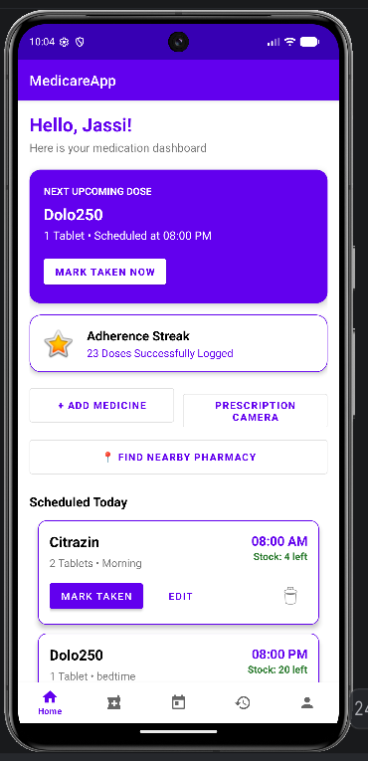
MediCare
MOBILE APPLICATION DEVELOPMENT · MINI PROJECT
An offline medication assistant for elderly patients
PRESENTED BY
PRESENTED TO
Bhavishya Singh · 70022400569
Dr. Preetjot Kaur
Jasman Rai · 70022400571
Notes:
Introduce yourselves and the app in one line: MediCare is an offline medication assistant for elderly patients. Keep this under 20 seconds.

Slide 2



Many daily medicines are hard to manage
THE PROBLEM
Missed doses
Empty strips
Lost records
Forget the time, or whether it was already taken
Notice the medicine ran out only when it is too late
Paper prescriptions and doctor advice get misplaced
Notes:
Our users are elderly patients on several medicines. Three things go wrong: they miss doses, they run out of stock without noticing, and they lose prescriptions.

Slide 3
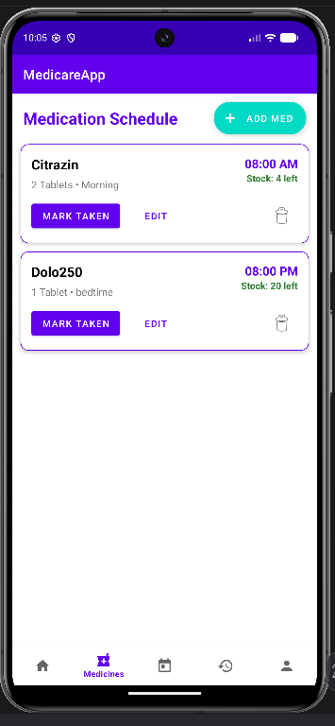






What MediCare does
FEATURES
Exact daily reminders
Full-screen alert + voice, Taken or Snooze · Reminder Alert
Medicine schedule
Add, edit, delete, track stock · Medicines, Add/Edit
Adherence history
Taken, snoozed, missed logged automatically · History
Low stock + nearby pharmacy
Refill alert, opens Google Maps · Home, Medicines
Doctor appointments
Date and time pickers, sorted list · Appointments
Records and emergency
Prescription photos, emergency dial, nearest hospital · Notes, Profile
Notes:
Six features, each with the screen it lives on. Exact reminders with a full-screen alert and voice. A medicine schedule with stock. Automatic history of taken, snoozed and missed doses. Low-stock alerts that open Google Maps for pharmacies. Doctor appointments. Prescription photos and emergency help on the profile.

Slide 4
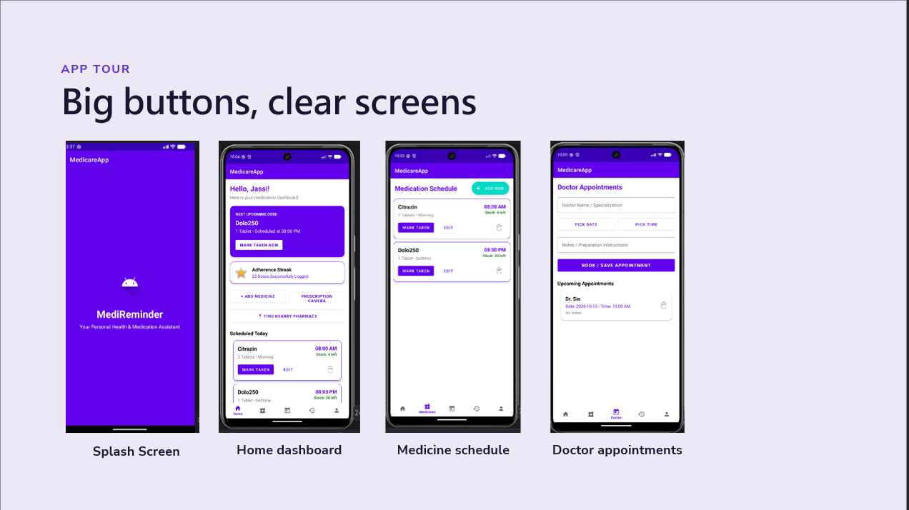

Slide 5
10 activities, one job each
SCREENS
Activity (Java + XML layout) | What it does
SplashActivity | Logo for 2 s, then opens Login or Home
LoginRegisterActivity | Register and log in
MainActivity | Home: next dose, quick actions, today’s medicines
MedicineListActivity | All medicines: edit, delete, mark taken
AddEditMedicineActivity | Medicine form with time picker; saves and sets the alarm
ReminderAlertActivity | Full-screen alert over lock screen; speaks; Taken / Snooze
AppointmentsActivity | Book doctor visits with date and time pickers
HistoryActivity | Dose log: taken green, snoozed orange, missed red
NotesPrescriptionsActivity | Camera photos of prescriptions with doctor notes
ProfileActivity | Emergency dial, nearest hospital, log out
Notes:
Every screen is an Activity, a Java class, paired with an XML layout. Splash routes to login or home. Login stores a hashed password. Home shows the next dose. Medicines and Add/Edit manage the schedule and set alarms. Reminder Alert appears at dose time. Appointments, History, Prescriptions and Profile cover the rest. A five-tab bottom bar connects them.

Slide 6

It rings even when the app is closed
HOW A REMINDER WORKS
1
2
3
4
Save medicine
Alarm fires
Alert + voice
Patient responds
Stored in Room, daily alarm set
AlarmManager wakes our BroadcastReceiver
Full-screen alert, medicine name spoken aloud
Every outcome is logged in History
Taken
Snooze
No response
Logged, stock goes down by 1
Rings again in 10 minutes
Logged as MISSED after 1 hour
Tomorrow’s alarm is set automatically, and all alarms are restored after a phone restart.
Notes:
This is the core of the app. Saving a medicine stores it in Room and sets an exact alarm. At dose time AlarmManager wakes our BroadcastReceiver, even if the app is closed. It shows a full-screen alert and speaks the medicine name. Taken lowers stock, snooze rings again in ten minutes, and no response is logged as missed after an hour. Alarms re-arm daily and survive a reboot.

Slide 7
The classes that do the work
BEHIND THE SCREENS
BACKGROUND
HELPERS (UTIL)
DATA
MedicationAlarmReceiver
AlarmScheduler
Room database
Runs at dose time: alert, voice, next alarm, missed check
Sets and cancels every alarm
4 tables: medicines, dose logs, appointments, records
DoseActions
BootReceiver
Logs doses, lowers stock, refill alert
DAOs
Restores all alarms after a phone restart
NearbyPlaces · TimeUtils
One per table: insert, update, delete, queries
Google Maps intent · time maths
Notes:
Screens don’t do the heavy work alone. Two receivers run in the background: one at every dose time, one after a restart. Helper classes hold shared logic: AlarmScheduler for alarms, DoseActions for logging and stock, NearbyPlaces for the Google Maps intent, TimeUtils for time maths. Data lives in a Room database with four tables and a DAO each, plus SharedPreferences for login.

Slide 8
Built on the course units
COURSE TOPICS APPLIED
Unit | Course topic | Where it is in MediCare
2 | Simple controls | Buttons and text fields on every form
2 | Screen layout | ConstraintLayout, LinearLayout, ScrollView
2 | Menus | Bottom navigation built from a menu XML
2 | Date and time pickers | Appointment date, dose and appointment time
2 | Toasts and pop-up dialogs | “Saved” toasts, delete confirmation dialogs
2 | Multiscreen application | 10 screens linked with intents
3 | Images on the device | Prescription photos with saved thumbnails
4 | Location with Google Maps | Nearest pharmacy and hospital
6 | SQLite database | Room on SQLite: medicines, logs, appointments, records
Notes:
Our app applies most of the course units. From Unit 2: controls, layouts, the bottom-navigation menu, date and time pickers, toasts and dialogs, and ten screens linked with intents. Unit 3: prescription photos stored on the device and shown as images. Unit 4: Google Maps for the nearest pharmacy and hospital. Unit 6: SQLite through Room, with four tables. On top of these, we self-learned the concepts on the next slide.

Slide 9
Beyond the syllabus
SELF-LEARNING
01
AlarmManager + BroadcastReceiver
Background reminders that survive app close and phone restart
02
Notification actions + full-screen alert
Taken and Snooze buttons, alert shown over the lock screen
Notes:
Three concepts we learned on our own, outside the course units: AlarmManager with BroadcastReceiver for background reminders, notification actions with a full-screen intent, and TextToSpeech for voice. Each one directly serves the elderly user.

Slide 10
Thank you
WHAT’S NEXT
Future scope
Caregiver alerts
Multiple doses a day
Notify family when a dose is missed
Several reminder times per medicine
Questions?
Notes:
Next steps: alert a caregiver when a dose is missed, support several dose times per medicine, and back up data with Firebase. Thank you. Happy to take questions or show a live demo.

